Slide 1

Nairobi County TB Prevalence survey 2022: Has the prevalence changed since 2016?
Dr Jane Rahedi Ong’ang’o
Principal Research Scientist,
CRDR, KEMRI

Slide 2
Introduction
Population-based TB prevalence surveys offer the most accurate estimates of TB burden
National and sub-national population-based surveys, when performed at intervals
may assess important changes in TB prevalence.
evaluate the impact of public health interventions,
identify characteristics associated with differences in TB prevalence
inform public health responses.
In 2022 we re-surveyed nine Nairobi County neighbourhoods that were previously surveyed in 2015.
Aims;
To determine pulmonary TB prevalence
Compare prevalence to 2015 estimates,
Evaluate changes in risk groups.

Slide 3
Methods 2015 vs 2022
 | 2015 | 2022
Census | 9 Nairobi geographic clusters | 9 Nairobi geographic clusters
Sample | Age: ≧ 15 years and resident of cluster 30 days or more Number of participants: 6,834 Participation rate:89% | Age: ≧ 15 years and resident of cluster 30 days or more Number of participants: 6369 Participation rate: 83%
Screening | Symptom screen : cough ≧ 2 weeks Digital CXR: Abnormal Suggestive of TB | Symptom screen : cough of any duration Digital CXR: Abnormal Suggestive of TB
Diagnosis | Spot and Morning sputum samples FM smear microscopy both samples Xpert MTB/RIF morning sample LJ solid Culture | Spot and Morning sputum samples FM smear microscopy both samples Xpert Ultra morning sample MGIT liquid Culture
Case Definition | Bacteriologically confirmed TB: Xpert MTB/RIF positive and /or culture MTB positive | Bacteriologically confirmed TB: Xpert Ultra positive minus trace and /or culture MTB positive

Slide 4
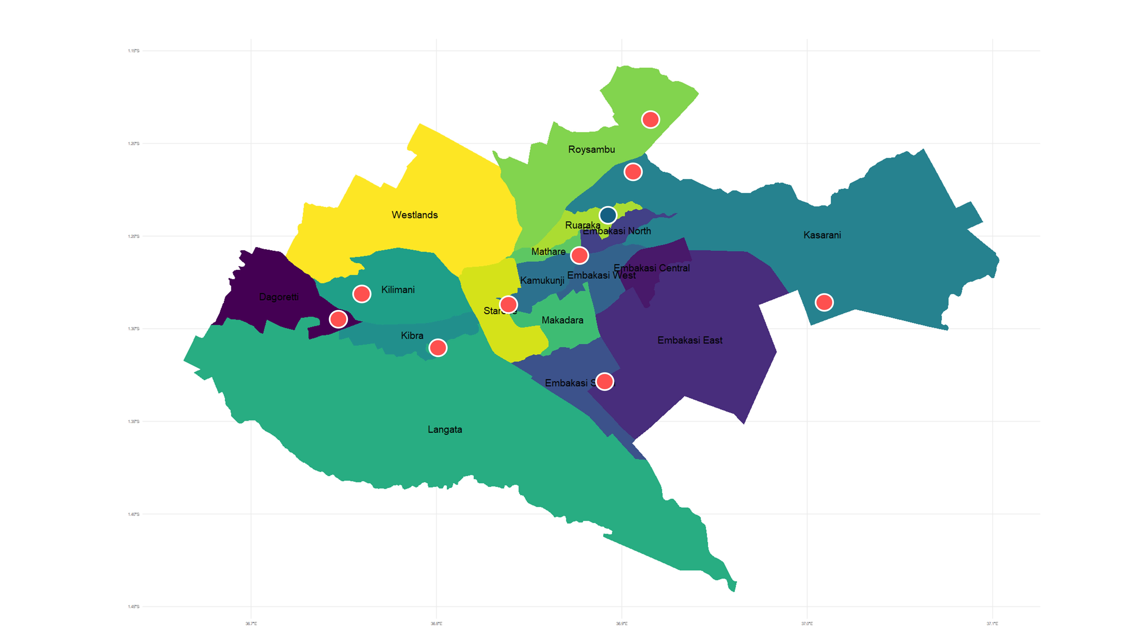
 | Cluster Name (2015)
1 | Kiamaiko/Ndururuno A
2 | Kasarani/Clay works Village
3 | Ruai/White House Manyatta
4 | Mukuru Kwa Njenga/ Jua Kali
5 | Gatina/Karama
6 | Riruta/Satellite B
7 | Laini Saba/Soweto East
8 | Muthurwa/Muthrwa Est B
9 | Konga Soweto/ Soweto 1
Map of sub-counties in Nairobi, Kenya, and locations of surveyed geographic clusters (red circles) and excluded cluster (blue circles).

Slide 5
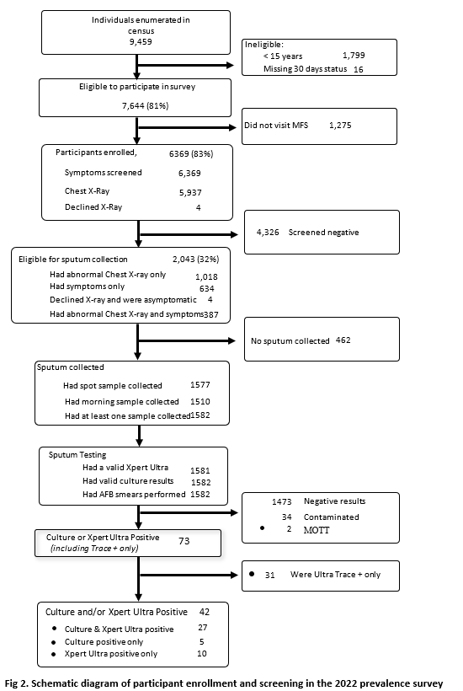

Slide 6
Comparison of symptoms characteristics of the study participants between 2015 and 2022 surveys
Characteristic | 2015, N = 6132 | 2022, N = 6,369 | p-value
Cough of any duration | 1,018 (17%) | 1,021 (16%) | 0·005
Cough (>2weeks) | 292 (4.8%) | 366 (6%) | 0·20
Chest pain | 782 (13%) | 625 (10%) | <0·001
Fever | 112 (1.8%) | 99 (2%) | 0.03
Night sweats | 160 (2.6%) | 140 (2%) | 0·09
Weight loss | 31 (0.5%) | 93 (2%) | <0·001
Shortness of breath | 406 (6.6%) | 239 (4%) | <0·001
Number of symptoms present |  |  | <0·001
No symptoms | 4,501 (73%) | 4,958 (78%)
Only 1 symptom | 979 (16%) | 839 (13%)
Only 2 symptoms | 403 (6.6%) | 330 (5%)
3 or more symptoms | 249 (4.1%) | 242 (4%)

Slide 7
Estimated weighted pulmonary TB prevalence in 2022 survey by cough duration and in 2015 survey
 | 2022: cough any duration | 2015: cough >2 weeks | 2022: cough >2 weeks
Robust standard errors with multiple imputation and inverse probability weighting | Bacteriologically Confirmed (N=42) Point estimate (95%CI) | Bacteriologically confirmed (N=33) Point estimate (95%CI) | Bacteriological Confirmed (N=39) Point estimate (95%CI) | P-value comparing 2022 restricted analysis to 2015
Overall | 806 (518, 1,096) | 567 (267, 866) | 761 (450, 1,073) | 0·41
GeneXpert positive TB | 602 (350, 854) | 491 (234, 747) | 556 (309, 804) | 0·70
Sex
Women | 455 (179, 730) | 306 (107, 505) | 439 (215, 664) | 0·34
Men | 1394 (802, 1,985) | 908 (388, 1,429) | 1301 (734, 1,868) | <0.001
Age
15-24 years | 407 (117, 697) | 339 (142, 436) | 449 (126, 773) | 0·43
25-34 years | 853 (251, 1,456) | 597 (174, 1,021) | 791 (311, 1,272) | 0.18
35-44 years | 875 (335, 1,414) | 615 (229, 1,003) | 814 (204, 1,425) | <0.001
45-54 years | 1,375 (361, 2,390) | 880 (75, 1,685) | 1,164 (452, 1,875) | <0.001
55-64 years | 1,115 (209, 2,021) | 832 (127, 1,537) | 1,102 (129, 2,074) | 0.44
65 years and older | 479 (0, 1,433) | 437 (0, 1,443) | 579 (0, 1,609) | 0.27
Point estimates of TB Prevalence are higher in 2022 compared to 2015

Slide 8
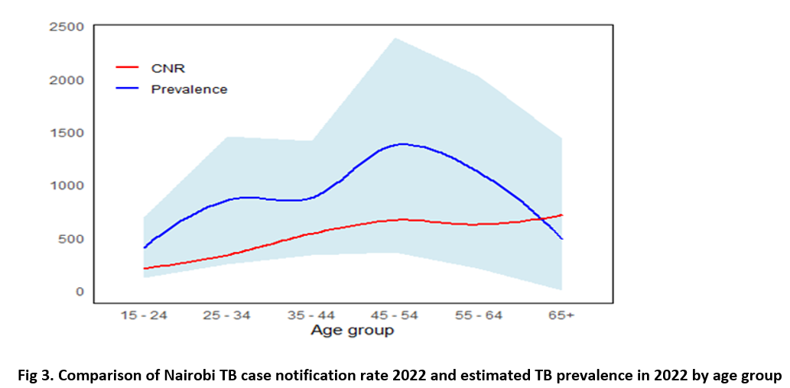

Slide 9
Participants diagnosed with TB in 2022 and 2015 by geographic cluster.
Cluster | Name | TB disease in 2022 | Number surveyed 2022 | Crude prevalence 2022 (per 100,000 persons) | TB disease in 2015 | Number surveyed 2015 | Crude prevalence 2015 (per 100,000 persons)
1 | Kiamaiko/Ndururuno A | 4 | 645 | 620 | 13 | 855 | 1520
2 | Kasarani/Clay works Village | 3 | 670 | 447 | 0 | 546 | 0
3 | Ruai/White House Manyatta | 5 | 637 | 784 | 3 | 595 | 504
5 | Mukuru Kwa Njenga/ Jua Kali | 0 | 697 | 0 | 2 | 702 | 284
6 | Gatina/Karama | 4 | 691 | 578 | 2 | 625 | 320
8 | Riruta/Satellite B | 5 | 704 | 710 | 2 | 544 | 367
9 | Laini Saba/Soweto East | 4 | 759 | 527 | 3 | 605 | 496
10 | Muthurwa/Muthrwa Est B | 6 | 787 | 762 | 3 | 815 | 368
11 | Konga Soweto/ Soweto 1 | 11 | 779 | 1412 | 5 | 835 | 368
Total |  | 42 | 6369 | 659 | 33 | 6132 | 538
Crude prevalence point estimates were higher in seven of the nine clusters in 2022 relative to 2015, although these differences were not significant.

Slide 10
Prevalent TB or Xpert Ultra Trace: reported symptoms and x-ray findings
Characteristic | Culture-positive, Ultra negative N = 5 | Culture-positive, Ultra Positive N = 37 | Culture-negative, Ultra Trace positive, N = 31 | Overall, N = 73 | p-value
Reported symptoms
Cough of any duration | 4 (80%) | 21 (57%) | 21 (68%) | 46 (63%) | 0.6
Cough > 2wks | 1 (20%) | 14 (39%) | 8 (29%) | 23 (33%) | 0.6
Unknown | 0 | 1 | 3 | 4
Fever | 0 (0%) | 4 (11%) | 2 (6.5%) | 6 (8.2%) | 0.8
Weight loss | 1 (20%) | 4 (11%) | 1 (3.2%) | 6 (8.2%) | 0.2
Night sweats | 1 (20%) | 6 (16%) | 2 (6.5%) | 9 (12%) | 0.3
Fatigue | 2 (40%) | 8 (22%) | 5 (16%) | 15 (21%) | 0.4
Shortness of breath | 0 (0%) | 6 (16%) | 7 (23%) | 13 (18%) | 0.6
Chest pain | 3 (60%) | 12 (32%) | 13 (42%) | 28 (38%) | 0.4
One or more of WHO screening symptoms (cough/fever/weight loss/night sweats) | 4 (80%) | 22 (59%) | 21 (68%) | 47 (64%) | 0.6
X-ray findings |  |  |  |  | 0·007
Normal | 2 (40%) | 2 (5.6%) | 10 (33%) | 14 (20%)
Abnormal, suggestive of TB | 3 (60%) | 34 (94%) | 20 (67%) | 57 (80%)
Unknown | 0 | 1 | 1 | 2
17/42 (40%) did not report a cough and 16/42 (38%) denied all of the WHO screening symptoms. (sub-clinical TB)
chest x-ray demonstrated higher sensitivity as 37/42 (88%) of participants with confirmed TB had an abnormal chest X-ray suggestive of TB.

Slide 11
Comparison of GeneXpert results from Xpert Ultra cartridge and Xpert MTB/RIF cartridge
Ultra cartridge results | MTB/RIF results |  |  |  |  |  | Total
 | MTB Very Low | MTB Low | MTB Medium | MTB High | MTB not Detected | Error
MTB Trace | 1 (10%) |  |  |  | 12 (90%) |  | 13 (32.5%)
MTB Very Low | 1 (30%) |  |  |  | 2 (70%) |  | 3 (7.5%)
MTB Low | 2 (20%) | 5 (60%) | 1 (10%) |  | 1 (10%) |  | 9 (22.5%)
MTB Medium |  | 1 (50%) | 1 (50%) |  |  |  | 2 (5%)
MTB High |  |  |  | 3 (100%) |  |  | 3 (7.5%)
MTB not Detected |  |  |  |  | 9 (90%) | 1 (10%) | 10 (25%)
Total | 4 (10%) | 6 (15%) | 2 (5%) | 3 (10%) | 24 (60%) | 1 (0%) | 40
Of the 13 samples that were trace positive by Xpert Ultra testing, only 1 was positive on GeneXpert MTB/RIF.
Fourteen (82%) of the 17 Xpert Ultra participants with positive results > trace were also test positive by GeneXpert MTB/RIF; thus, Xpert Ultra detected 3 additional persons with tuberculosis.

Slide 12
Key Findings /Discussion 1/2
Estimated TB prevalence in nine geographic clusters in Nairobi County remained high from 2015 to 2022.
Despite programmatic interventions after the 2015 survey, there was no evidence of a decline in TB overall, by sex, or in age subgroups
Men and 45-54 year old participants belonged to groups with higher risk for TB in these geographic clusters in both 2015 and 2022.
This suggests that in Nairobi County, local drivers of the TB epidemic are stable and may be used to develop targeted TB control interventions. Without specific interventions, it is likely that TB burden will remain high.
In comparing our results from 2022 and 2015, it is important to note that the TB detection methods used in 2022 were more sensitive than those used in 2015.
Liquid broth-based culture is estimated to be approximately 16% more sensitive than culture on solid media [1],
a meta-analysis of studies that directly compared GeneXpert assays found that, compared to culture, the sensitivity of Xpert Ultra and Xpert MTB/RIF were 90.9% and 84.7%, respectively, a difference of 6.3% [2]
In a limited head-to-head comparison, we also found that Xpert Ultra detected more people with TB than Xpert MTB/RIF
1. Cruciani M, Scarparo C, Malena M, Bosco O, Serpelloni G, Mengoli C. Meta-analysis of BACTEC MGIT 960 and BACTEC 460 TB, with or without solid media, for detection of mycobacteria. J Clin Microbiol. 2004;42(5):2321-5
2. Zifodya JS, Kreniske JS, Schiller I, Kohli M, Dendukuri N, Schumacher SG, et al. Xpert Ultra versus Xpert MTB/RIF for pulmonary tuberculosis and rifampicin resistance in adults with presumptive pulmonary tuberculosis. Cochrane Database Syst Rev. 2021;2:CD009593

Slide 13
Key Findings /Discussion 2/2
Beyond differences in testing, additional factors likely to have contributed to the persistently high TB burden in 2022.
health services disruptions in the two years immediately preceding the 2022 survey, including a COVID-19 related decrease in TB case notifications and a Kenyan healthcare worker strike in December 2020 – January2021 followed by TB case notifications subsequently increased
a significant increase in participants who were unemployed in 2022 compared to 2015, which may predispose to economic deprivation and higher TB risk
The likelihood of missing participants with TB who were without cough or abnormal chest x-ray is high.
importance of sub-clinical or asymptomatic TB as a large proportion of prevalent TB and as a likely driver of ongoing TB transmission
require novel methods to address diagnostic gaps including point-of-care testing

Slide 14
Recommendations
Active case-finding approaches need to identify strategies to increase inclusion of men such as enrollment through non-household locales or performing screening outside of business hours
Active case-finding among 45-64 year-old men in Nairobi County may be a strategy to maximize the detection of TB.
Future work should explore factors such as overcrowding, poor ventilation, poverty, and limited access to healthcare in these neighborhoods to help identify more targeted interventions to address the root causes driving TB transmission in these high-risk areas.

Slide 15
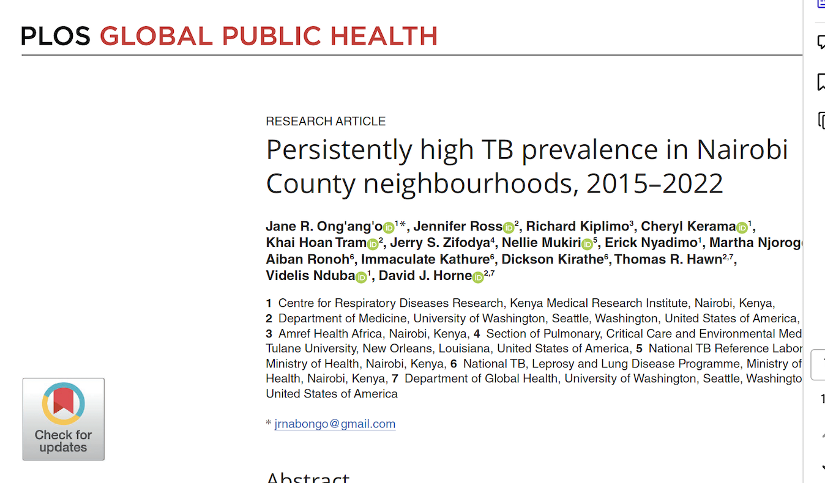

Slide 16
Acknowledgement
Individual study participants and their families
community resource persons (CHPs, Village Elders Chiefs, Local Adminstration)
Nairobi County TB Coordinators
Nairobi County health management team
National TB Program
KNBS
University of Washington
CRDR KEMRI Study staff

